Slide 1



Arduino 3 – RGB LED
Steven hammer
s.hammer@hw.ac.uk

Slide 2
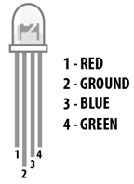
introduction
Use an Arduino with PWM outputs to control the colour of an RGB LED

Slide 3
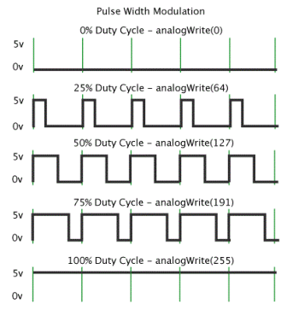
What is pwm?
PWM = Pulse Wave Modulation
Switch on/off at varying frequencies to control LED brightness

Slide 4
What are we doing today?
Set the RGB LED to illuminate with various colours (yellow, purple, navy…)
Use a potentiometer to control fading between different colours

Slide 5
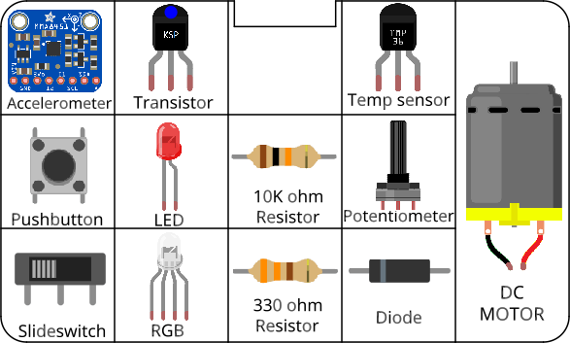
Circuits
All components included in the kit…

Slide 6
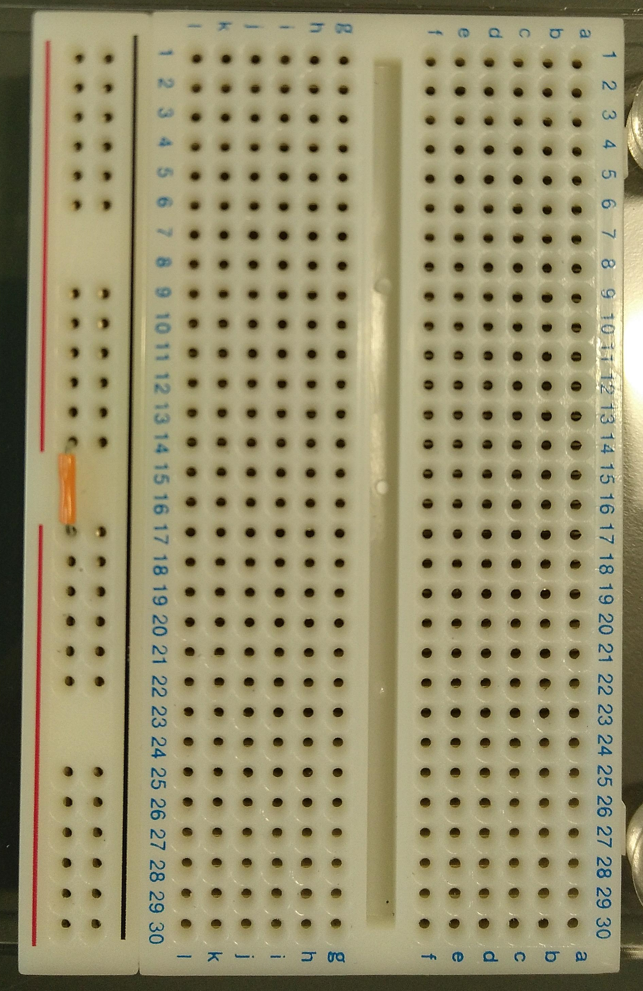
Before you start Building circuits…
Connect power bus (+ line) together using a small section of jumper cable

Slide 7
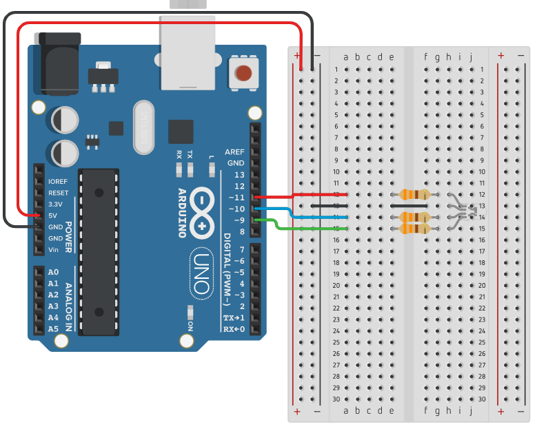
Building circuits
Insert components into breadboard holes
Connect up using instrument wire
Arduino controls inputs and outputs
Follow schematics
NOTE: GND = negative

Slide 8
Debugging code
Is there a space missing somewhere?
Do all lines end with a semicolon;
Is something commented out //

Slide 9
housekeeping
Take two boxes:
One Arduino box
One Sensors and Motion kit
Put components back into labelled places in boxes after use
Any components missing – let us know.

Slide 10
TIDYING up
Return components to your Sensors and Motion box IN THE CORRECT PLACES!!!
Put instrument wire in motor compartment
Return Arduino to its case
Return both boxes to tutor

Slide 11
Finished already?
Try fading through a rainbow – fade between red, orange, yellow, green, blue, indigo and violet. Control the time that each colour is illuminated using the potentiometer.
Create a dimmer switch – choose a single colour, and control brightness using input from the potentiometer
Control colour using input from the potentiometer

